Slide 1
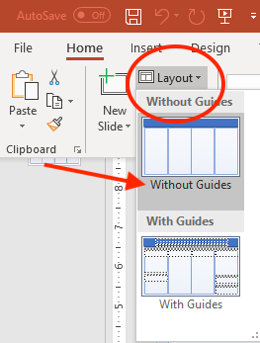
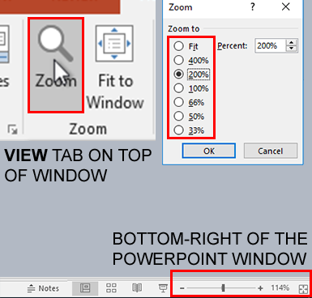

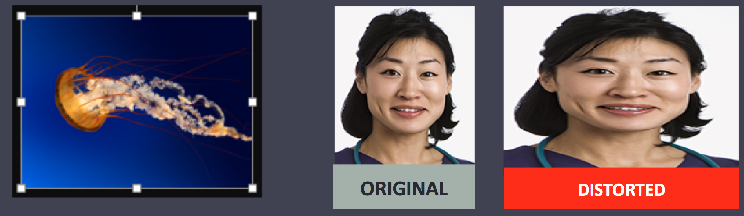
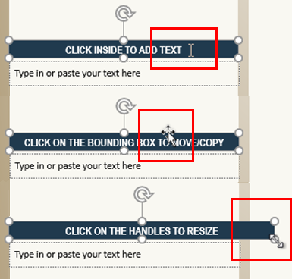

QUICK START GUIDE (THIS SIDEBAR WILL NOT PRINT)
This PowerPoint template produces a 36"x72" presentation poster. You can use it to create your research poster by placing your title, subtitle, text, tables, charts and photos. We provide a series of online tutorials that will guide you through the poster design process and answer your poster production questions. For complete template tutorials, go online to PosterPresentations.com and click on the HELP DESK tab. To print your poster using our same-day professional printing service, go online to PosterPresentations.com and click on "Order your poster".
This is a template for a presentation poster 36 inches tall by 72 inches wide | Important: Check the template size Before you start working on your poster and to avoid printing problems check that you have downloaded and that you are using the correct size template for your poster presentation. This template can also be printed at the following sizes without distortion and without any additional formatting: 42 tall x 84 wide 48 tall x 96 wide
 | How to Zoom in and out Use the PowerPoint zoom tool to adjust the screen magnification to view comfortably. PowerPoint provides 2 ways to zoom: 1. On the top menu bar click on the VIEW tab and then click on ZOOM. Choose the zoom percentage that works best for you. 2. For better zoom flexibility, use the zoom slider at the bottom right of the window.
Ruler and Guides The dotted lines on his poster template are guides. The horizontal and vertical guides will help you align your poster elements accurately. Text boxes and other elements will ”snap” to the guides and stay within the boundaries of the columns. To hide the guides go to VIEW and uncheck the Guides box.
 | Headers and text containers Included in this template are commonly used section headers such as Abstract, Objectives, Methods, Results, etc. - Click inside a section header to add its text. - To add another header, click on edge of the section box so that it is outlined. Copy and paste it. - To increase its size, click on the white circles and expand to the the desired size.
Adding content to the poster Start by adding your text to each section without spending too much time with formatting. Use the default font size even if your text extends beyond the bottom of the poster. Continue until you have added all your content including text, graphics, photos, etc. Once you finish adding your content you can go back and format your text as needed. If you run out of room, try to reduce the size of your fonts and/or the size of your graphics. If there is a lot of empty space try to increase your font sizes and the size of your graphics. The font used for references can be smaller.
Photos You can add photos by dragging and dropping from your desktop, copy and paste, or by going to INSERT > PICTURES. Resize images proportionally by holding down the SHIFT key and dragging one of the white corner handles (dots). For a professional-looking poster, do not distort your images by stretching them disproportionally.
Quality check your graphics Zoom in and look at your images at 100%-200% magnification. If they look clear, they will print well.
QUICK START GUIDE (THIS SIDEBAR WILL NOT PRINT)
How to change the template colors You can change the overall template color theme by clicking on the COLORS dropdown menu under the DESIGN tab. You can see a tutorial here: https://www.posterpresentations.com/how-to-change-the-research-poster-template-colors.html You can also manually change the color of individual elements by going to VIEW > SLIDE MASTER. On the left side of your screen select the background master where you can change the template background, column sizes, etc. After you finish working on the SLIDE MASTER, it is important that you go to VIEW > NORMAL to continue working on your poster.
How to change the column layout configuration You can manually change the configuration on the columns by going to VIEW > SLIDE MASTER. You can delete columns, resize them or modify them as needed for your layout. You can see a tutorial here: https://www.posterpresentations.com/how-to-change-the-column-configuration.html
 | How to hide the QUICK START GUIDE bars from the sides of the template The Quick Start Guides are outside the template’s printable area and they will not be on the printed poster. If you create a PDF file from your template, the guides will not be included. To hide the guides click on the Home tab (top of the screen) and then click on the Layout button below to see the available layouts. Choose the Without Guides layout.
How to preview your poster prior to printing You can preview your poster at any time by pressing the F5 key on your keyboard. You will see on the screen what's on your poster and how it should look when printed. Press the ESC key to exit Preview. | F5
How to print your poster When you are ready to have your poster printed go online to PosterPresentations.com and click on the "Order Your Poster" button. You can have your poster printed on professional papers, fabric for easy traveling and a variety of other materials. If you submit a PowerPoint document, you will be receiving a PDF proof for your approval prior to printing. If your order is placed and paid for before noon (Pacific time) Monday-Friday, your order will ship out that same day. FedEx Next day, Second day, Third day, and Free Ground services are offered. Go to PosterPresentations.com for more information.
© 2019 PosterPresentations.com 2117 Fourth Street , STE C Berkeley CA 94710 USA | For complete tutorials visit: https://www.posterpresentations.com/helpdesk.html

